Slide 1
Network Security
Review of Selected Materials
Phillip Mak
pmak@nyu.edu

Slide 2
Logistics
Midterm -- Saturday, 15 March, starting time between 1 – 3 PM ET
2 hours long
Covers all topics except for Lesson 4 slides 41+
The midterm exam is open book, open notes, open VM, and open Internet. However, it must be performed individually -- you may not collaborate or discuss the exam with anyone until the exam grade is released. Please see the definitions of cheating and unauthorized collaboration in the Student Code of Conduct.
Example of unauthorized collaboration is posting questions or reading answers with other students during the exam, or though a forum or question and answer site.
Usage of ChatGPT or any other AI content generation tools would be considered Plagiarism. Plagiarism checkers such as Turnitin and similar will be used
The timer does not stop even if you submit or close the window
No bonus exercises this week.
Excused Absence. If you get sick, don’t take the exam. Get documentation.
https://engineering.nyu.edu/student-life/office-student-affairs/policies
Here are the things you should be working on:
Review the sample midterm problems
Review the Crypto lecture
HW1 & 2, Labs 1 & 2

Slide 3
Objectives
Review selected materials for the midterm exam
Lab 1 / Lab 2 / HW #2
Lesson 1-3 and 5
(No lesson 4 – see last week’s video)

Slide 4
Lab 1 Review

Slide 5
Connection flooding: Overwhelming connection queue w/ SYN flood
Recall client sends SYN packet with initial seq. number when initiating a connection.
TCP on server machine allocates memory on its connection queue, to track the status of the new half-open connection.
For each half-open connection, server waits for ACK segment, using a timeout that is often > 1 minute
Attack: Send many SYN packets, filling connection queue with half-open connections.
Can spoof source IP address!
When connection queue is exhausted, no new connections can be initiated by legit users.
Need to know of open port
on victim’s machine: Port
scanning.
Notes:
SYN / SYN-ACK opening too many connections

Slide 6
DoS: Overwhelming connection queue with SYN flood
amateur attack:
SYNs with
Source IP = Alice
attacker
Connection queue
freed up with
RST segment
SYN-ACKs
victim
RST
Alice
Expert attack: Use multiple source IP
addresses, each from unresponsive
addresses.

Slide 7
SYN flood defense: SYN cookies (1)
SYN with ISN_{A}
SYN-ACK with ISN_{B}= cookie
Host A
Host B
When SYN segment arrives, host B calculates function (hash) based on:
Apache example: Source and destination IP addresses and port numbers, and a secret number
Host B uses resulting “cookie” for its initial seq # (ISN) in SYNACK
Host B does not allocate anything to half-open connection:
Does not remember A’s ISN
Does not remember cookie

Slide 8
SYN flood defense: SYN cookies (2)
If SYN is legitimate
Host A returns ACK
Host B computes same function, verifies function = ACK # in ACK segment
Host B creates socket for connection
Legit connection established without the need for half-open connections
If SYN-flood attack with spoofed IP address
No ACK comes back to B for connection.
No problem: B is not waiting for an ACK

Slide 9

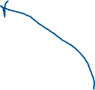
TCP RST Attack
Alice telnet
Bob
Alice
TCP RST
Must have correct
SEQ and ACK numbers
Attacker
Attacker can break the TCP connection by sending a TCP RST
Must match the SEQ and ACK Numbers

Slide 10




Session hijacking
Take control of one side of a TCP connection
Marriage of sniffing and spoofing
Alice telnet
Bob
Alice
“malicious command”
Correct SEQ/ACK
Attacker

Slide 11
Session hijacking: The details
Attacker is on segment where traffic passes from Alice to Bob
Attacker sniffs packets
Sees TCP packets between Bob and Alice and their sequence numbers
Attacker jumps in, sending TCP packets to Bob; source IP address = Alice’s IP address
Bob now obeys commands sent by attacker, thinking they were sent by Alice
Principal defense: encryption w/ auth protocol
Attacker does not have keys to encrypt and insert meaningful traffic

Slide 12
Session hijacking: limitation
2. to resync, Alice
sends segment with
correct seq #
1. weird ACK # for data never sent
Alice
Bob
3. “thanks bob”
Attacker’s solution:
Stop Alice from communicating with Bob
Poison the ARP Cache
Send unsolicited ARP replies to Alice and Bob with non-existent MAC addresses
Overwrite IP-to-MAC ARP tables so Alice’s segments will not reach Bob and vice-versa
But attacker continues to hear Bob’s segments, communicates with Bob
Bob is getting segments
from attacker and Alice.
Source IP address same,
but seq #’s different.
Bob likely drops
connection.
Attacker

Slide 13
Lab 2 Review
Q1: Use sniff() to capture packets. Learn how to use filter=
Q2: Spoof ICMP echo request packets
Q3: Write an ICMP traceroute program
Q4: sniff() icmp echo-request, and spoof echo-replies
Q4.2: ping 1.2.3.4
Q4.3: ping 10.9.0.99 (does not work, explain why)
Q4.4: ping 8.8.8.8
Q5: extra credit. Make Q4.3 (ping 10.9.0.99) work by using ARP cache poisoning (write a scapy program to perform ARP cache poisioning)

Slide 14
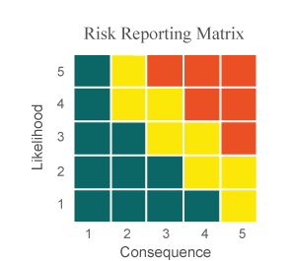




Risk Matrix
Level | Likelihood | Probability of Occurrence
5 | Near Certainty | ~ 90%
4 | Highly Likely | ~ 70%
3 | Likely | ~ 50%
2 | Low Likelihood | ~ 30%
1 | Not Likely | ~ 10%
Level | Consequences
5 | Severe
4 | Significant
3 | Moderate
2 | Minor
1 | Minimal or no consequences

Slide 15
Exercise A
What is residual risk?

Slide 16

Mitigating Risk
Example Risk #1: The software is really buggy and will likely have buffer overflow vulnerabilities. Reduce the likelihood of this risk by spending more resources to reduce defects.
Example Risk #2: There’s a 70% chance the website will be hacked and 1 million credit card numbers will be lost. Reduce consequences by not storing full credit card numbers. Likelihood reduced by adding a web firewall.
#2
#1
Residual risk is the remaining risk after mitigations

Slide 17
Quantitative Risk Assessment Example
Fire Damage to a building:
Asset Value: value of the building - $750,000
Single Loss Expectancy (SLE: Asset Value x Exposure Factor) - $250,000 (damage caused by the fire)
Annualized Rate of Occurrence (ARO) - .05 (5% chance every year that there will be a fire)
Annualized Loss Expectancy (ALE: $250,000 x .05) = $12,500
So does a fire alarm system which costs $5000/year to maintain and $15k to install initially worth it?
 | No fire alarm | Fire alarm
Year 1 | 12,500 | $20,000
Year 2 | 25, 000 | $25,000
Year 3 | 37,500 | $30,000

Slide 18

Distributed DoS: DDos
Attacker takes over many machines,
called “bots”. Potential bots are
machines with vulnerabilities.
DNS
Response: up to 512b (UDP)
bot
attacker
Internet
bot
victim
bot processes wait
for command from
attacker to flood a target
bot

Slide 19
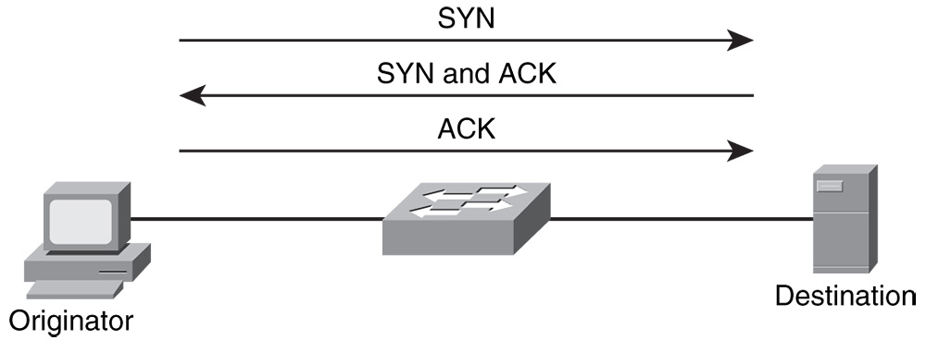
Port Scanning
Port scanners send TCP and UDP packets to various ports to determine if a process is active
TCP 80 (web server)
TCP 23 (telnet server)
UDP 53 (DNS server)
TCP scanning based on 3 way handshake
CS 6823 - Network Security
19

Slide 20
Exercise B
What are the possible responses to a TCP SYN packet, and the reasons why for each?
UDP?

Slide 21
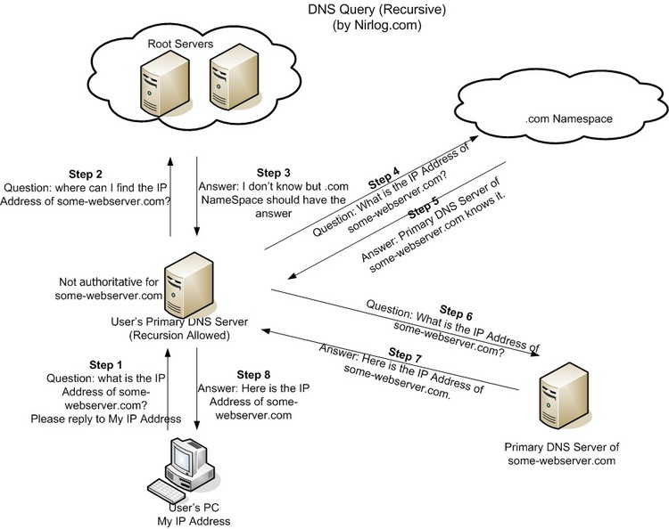
Interlude: How DNS Works

Slide 22
Exercise C
Suppose an attacker wants to perform DNS cache poisoning so that the website www.nytimes.com to be diverted to www.evil.com
a. [2 pts] If DNS cache poisoning was successful, would the user’s browser show www.nytimes.com or www.evil.com? Explain.
b. [4 pts] Suppose an attacker is deciding between attempting to spoof the DNS response on Step 7, or to spoof the DNS response on Step 8. Explain the difficulty of performing each of these attacks.
c. [4 pts] Explain which users will be affected if the attacker successfully spoofs Step 7 as compared to if the attacker successfully spoofs Step 8.
d. Which step would the attacker spoof to affect ALL users of nytimes.com for Verizion FIOS including science.nytimes.com and policitcs.nytimes.com

Slide 23
DNS attack: redirecting
hub or
WiFi
1
network
client
local DNS
server
2
Issues:
Must spoof IP address: set to local DNS server (easy)
Must match reply ID with request ID (easy if on the same LAN) – transaction ID
May need to stop reply from the local DNS server (harder)
attacker
Client sends DNS query to its local DNS server; sniffed by attacker
Attacker responds with bogus DNS reply
Notes:
Client accepts first correct response

Slide 24
IP address spoofing (1)
SA: 36.220.9.59
DA: 212.68.212.7
145.13.145.67
212.68.212.7
Attacker doesn’t want actions traced back
Simply re-configure IP address in Windows or Unix.
Or enter spoofed address in an application
e.g., decoy packets with Nmap

Slide 25
IP address spoofing (2)
145.13.145.67
SA: 36.220.9.59
DA: 212.68.212.7
212.68.212.7
victim
alice
36.220.9.59
SA: 212.68.212.7
DA: 36.220.9.59
But attacker cannot interact with victim.
Unless attacker is on path between victim and spoofed address.

Slide 26
IP spoofing with TCP?
Can an attacker make a TCP connection to server with a spoofed IP address?
Not easy: SYN-ACK and any subsequent packets sent to spoofed address.
If attacker can guess initial sequence number, can attempt to send commands
Send ACK with spoofed IP and correct seq #, say, one second after SYN
But TCP uses random initial sequence numbers.

Slide 27
Diffie-Hellman
Allows two entities to agree on shared key.
But does not provide encryption
n is a large prime; g is a number less than n.
n and g are made public
a-secret, g, n
A=gª mod n
K=Bª mod n
b-secret
B=g^{b} mod n
K=A^{b} mod n
g, n, A
B
Trudy – sees g, n, A, B, but cannot decipher K

Slide 28
Diffie-Hellman (cont)
Alice and Bob agree to use a prime number n=23 and base g=5.
Alice chooses a secret integer a=6, then sends Bob A = gª mod n
A = 5⁶ mod 23
Bob chooses a secret integer b=15, then sends Alice B = g^{b} mod n
B = 5¹⁵ mod 23
Alice computes s = Bª mod n
Bob computes s = A^{b} mod n

Slide 29
Exercise D1
n=23 and base g=5.
Alice chooses a secret integer a=6
Bob chooses a secret integer b=15
Alice
Bob
a=6 (secret), g=5, n=23
A=gª mod n
A=5^6 mod 23 = 8
K=B^ a mod n
K=19^6 mod 23
K=2
b=15 (secret)
B=g^{b} mod n
B=5^15 mod 23 = 19
K=A^b mod n
K = 8^15 mod 23
K = 2
A=8. g=5, n=23
B = 19
K=2
K=2

Slide 30
Exercise D2
Alice
Bob
a=9, g=2, n=11
A=gª mod n
K=Bª mod n
b=4
B=g^{b} mod n
K=A^{b} mod n
A, g, n
B

Slide 31
RSA: Creating Public/Private Keypair
1. Choose two large prime numbers p, q.
(e.g., 2048 bits each)
2. Compute n = pq, Φ = (p-1)(q-1)
3. Choose e (with 1<e< Φ) that has no common factors
with Φ. (e, Φ are “relatively prime”).
4. Choose d such that ed-1 is exactly divisible by Φ.
(in other words: ed mod Φ = 1 ; or d = e mod Φ)
-1
5. Public key is (n,e). Private key is (n,d).
{
{
K
+
K
-
B
B

Slide 32
Exercise E
Using p=5, q=13. Compute n, Φ, e, and d. Use the smallest value of e.

Slide 33
RSA: Creating Public/Private Keypair
1. Choose two large prime numbers p=5, q=13.
(e.g., 1024 bits each)
2. Compute n=p*q=65 and Φ=(p-1)(q-1)=48
3. Choose e: (1) 1<e< Φ ; (1) e & Φ(48) are “relatively prime”
Possible values of e: 5, 7, 11, 13, 17, 19, 23, 25, 29, 31, 35, 37, 41, 43, 47
(e can never be even)
4. Choose d such that ed-1 is exactly divisible by Φ.
(in other words: ed mod Φ = 1 ; or d = e mod Φ)
5. Public key is (n,e)=> . Private key is (n,d)=>.
{
{
K
+
K
-
B
B

Slide 34
4. Choose d such that ed-1 is exactly divisible by Φ.
(in other words: ed mod Φ = 1 ; or d = e mod Φ)
Let take e=5
5d mod 48 = 1
D=29
5. Public key is (n,e). Private key is (n,d).
(65,5). (65,29)

Slide 35
RSA encryption & decryption
Encrypt: m=10
C = m^e mod n
C=10^5 mod 65 = 30
M=c^d mod n
M=30^29 mod 65 = 10

Slide 36
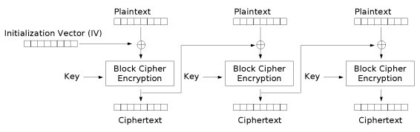
Exercise F (CBC)
111
111
111
101
(Encryption Algo)
Input Output
000 110
001 111
010 100
011 101
100 011
101 010
110 001
111 000
100
101
100
Encrypt: IV = 101 plaintext= 111 111 111
ciphertext = 100 101 100
CT1= Enc(IV XOR PT1)
CT2=Enc(CT1 XOR PT2)
CT3= Enc(CT2 XOR PT3)

Slide 37
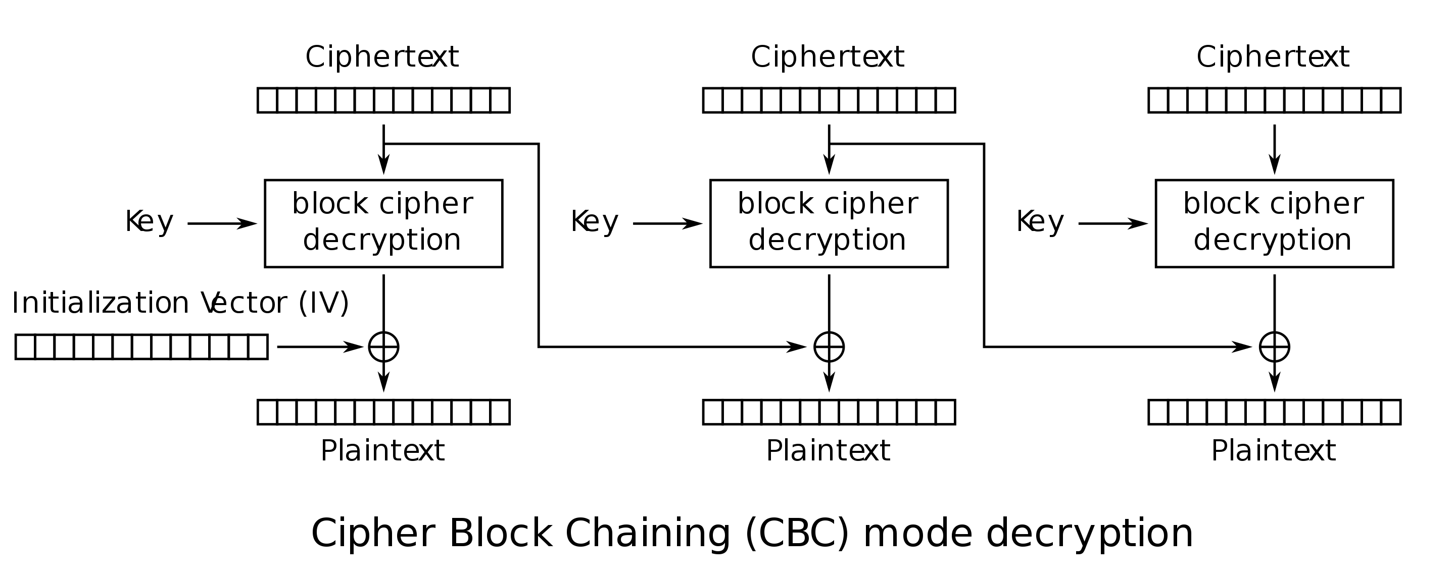
101
100
100
101
Input Output
000 110
001 111
010 100
011 101
100 011
101 010
110 001
111 000
ciphertext = 100 101 100
Plaintext = 111 111 111

Slide 38
Ex. F2 CBC Decryption
Input Output
000 110
001 111
010 100
011 101
100 011
101 010
110 001
111 000

Slide 39
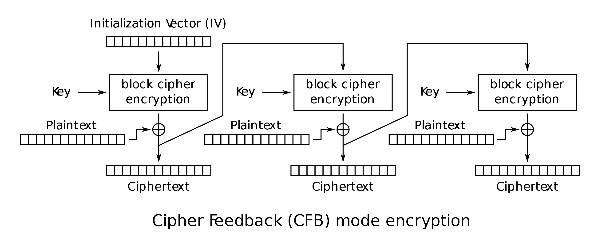
Exercise G (CFB)
Input Output
000 110
001 111
010 100
011 101
100 011
101 010
110 001
111 000
IV=000 encrypt 001 001 001

Slide 40
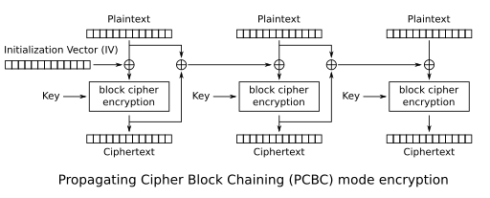
Exercise G2 (PCBC)
Input Output
000 110
001 111
010 100
011 101
100 011
101 010
110 001
111 000
IV=000 encrypt 001 001 001

Slide 41
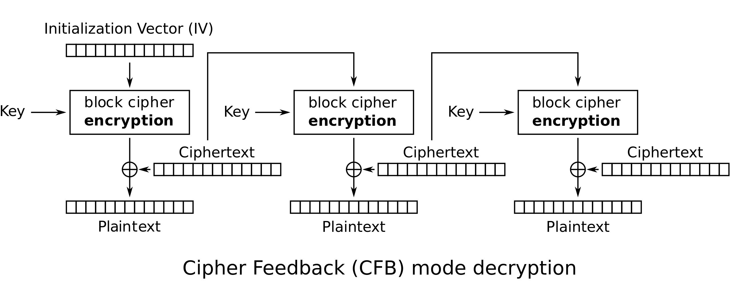
Exercise H (Decrypt CFB)
Input Output
000 110
001 111
010 100
011 101
100 011
101 010
110 001
111 000

Slide 42
Do example on OFB

